Slide 1
Credit Card Approval Prediction
Samuel Adedokun
Sakshi Joshi
Maria Valentina
Srinidhi Lakshminarayanan
Uzwa Mazhar
Shakthi Viswanathan

Slide 2
Objective
To enable a bank is to decide whether to issue a credit card to an applicant or not.
Achieved by predicting the probability of future defaults and credit card borrowings using personal information and data submitted by credit card applicants.

Slide 3
Credit Card Approval Prediction Dataset
Source: Kaggle
Link: https://www.kaggle.com/rikdifos/credit-card-approval-prediction#application_record.csv
Data files:
application_record.csv - Personal information of the applicant
Credit_record.csv – Credit behaviour of the applicant
Total Observations: 631765
Total Features: 17

Slide 4
More about the Data
RESPONSE VARIABLE | BINARY VARIABLE | MULTI- CATEGORICAL VARIABLES | CONTINUOUS VARIABLES
Status | Gender Having a car or not Having house realty or not Having a phone or not Having an email or not Having a Work Phone or not | Income Type Occupation Type House Type Education Marriage Condition | Number of Children Annual Income Age Working Years Family Size Monthly Balance

Slide 5
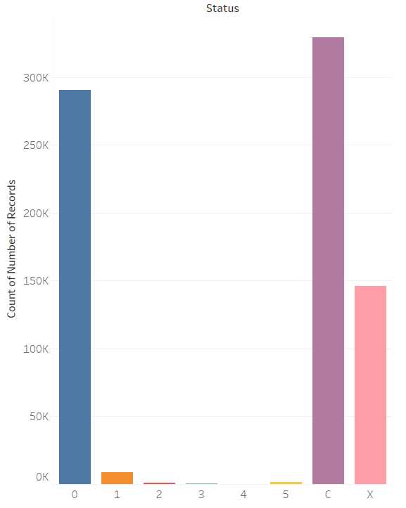
Data Processing
Following were the original levels of the Status variable :
0: 1-29 days past due
1: 30-59 days past due
2: 60-89 days overdue
3: 90-119 days overdue
4: 120-149 days overdue
5: Overdue or bad debts for more than 150 days
C: paid off that month
X: No loan for the month

Slide 6
Business Logic
Removed values corresponding the Status X
All C values transformed to 0 and other values transformed to 1
New data is balanced with 48% defaulters

Slide 7
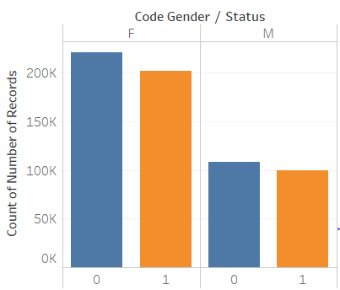
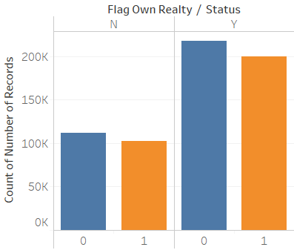
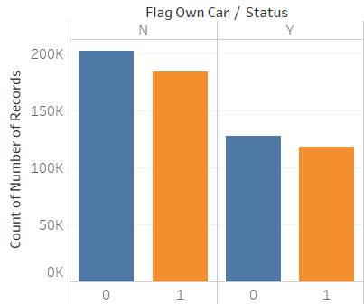
EDA
Binary Variable
Categorical Variable
Continuous Variable

Slide 8
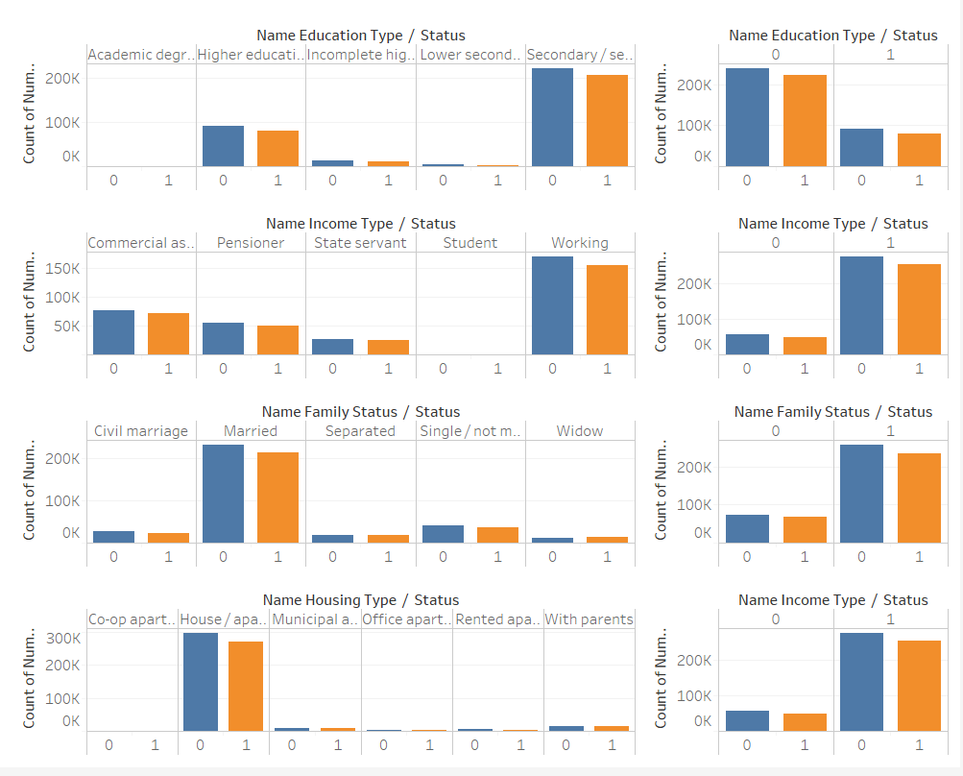
EDA
Binary Variable
Categorical Variable
Continuous Variable

Slide 9
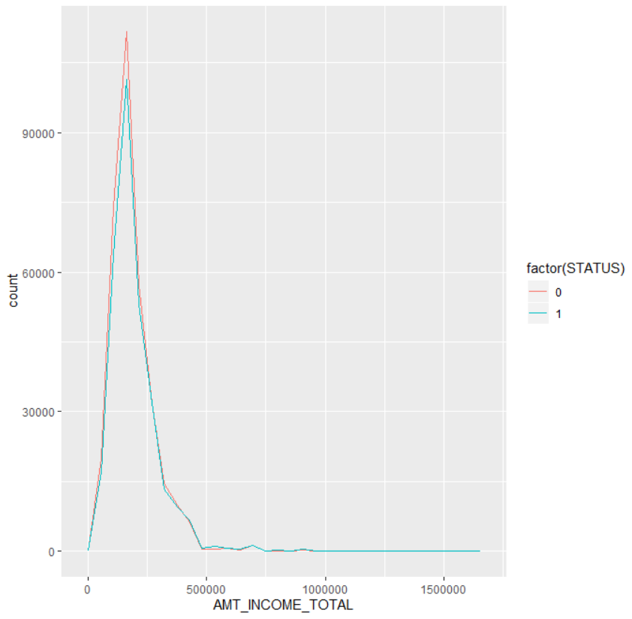
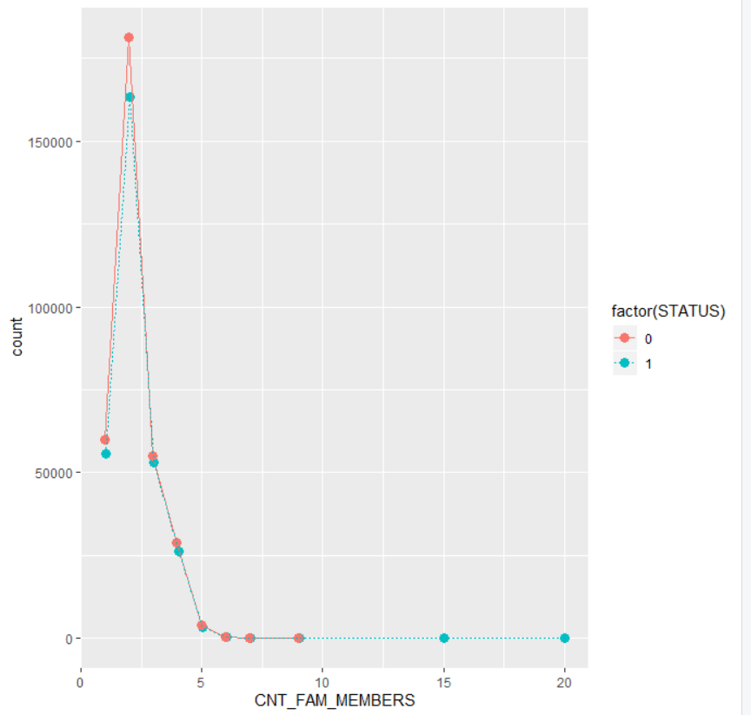
EDA
Binary Variable
Categorical Variable
Continuous Variable

Slide 10
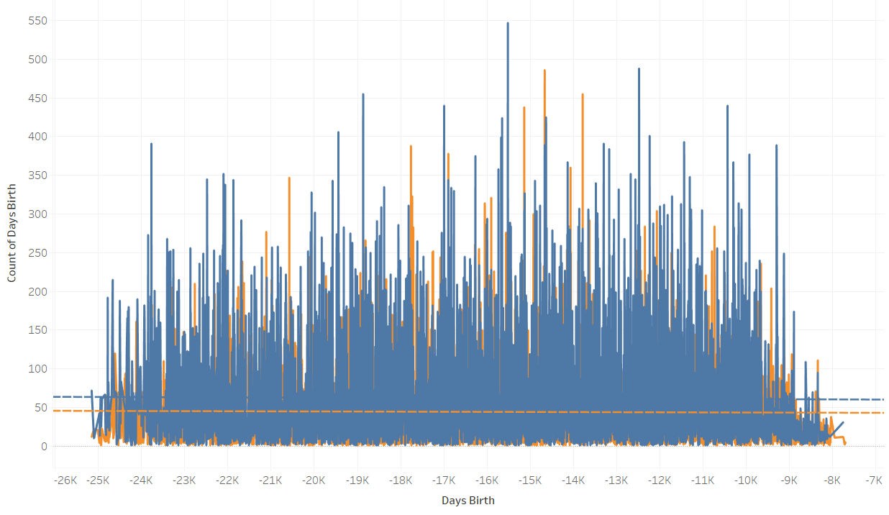
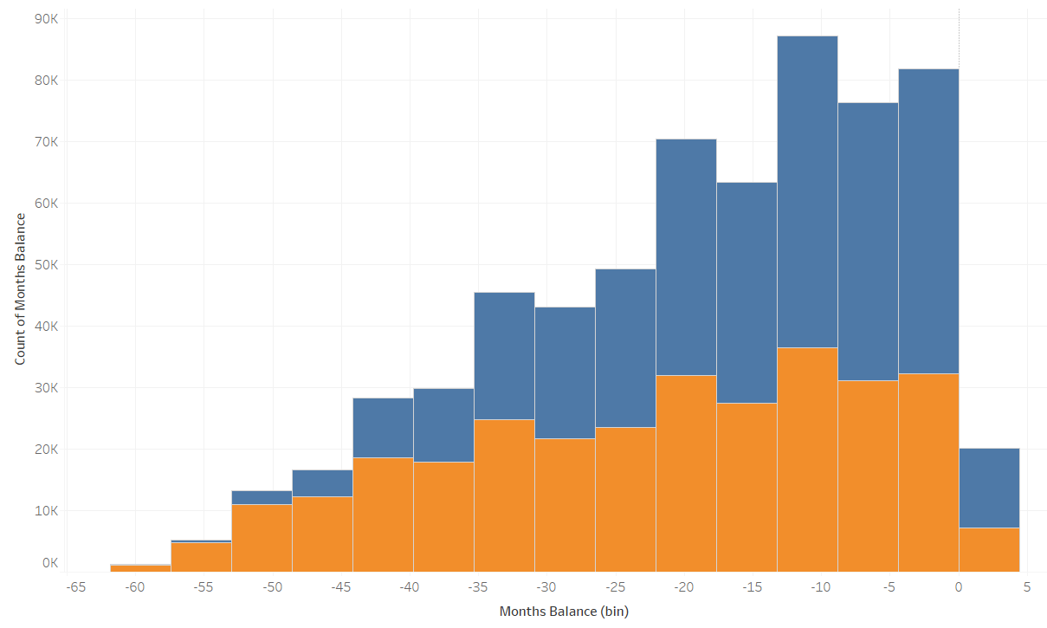

EDA
Binary Variable
Categorical Variable
Continuous Variable

Slide 11
Hypothesis Testing
SIGNIFICANT FEATURES | NOT SO SIGNIFICANT FEATURES
Gender Ownership of a car Number of children Annual Income Whether the applicant owns a work phone Whether the applicant owns a phone Whether the applicant has an email The size of their family Their income type Education Level Marital Status Working Years Monthly Balance | Occupation Type Housing Type Age Do they own property/house

Slide 12
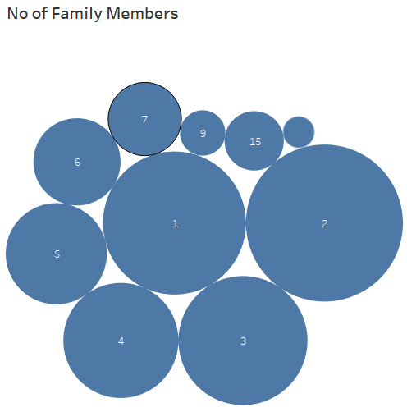
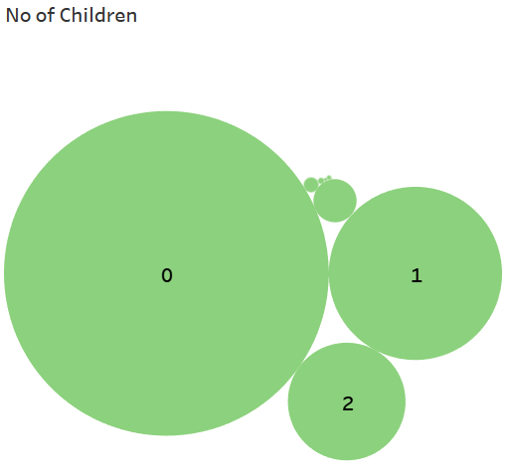
Some Strong relationships
The No of Children and No of Family members had a strong correlation factor of 0.89

Slide 13
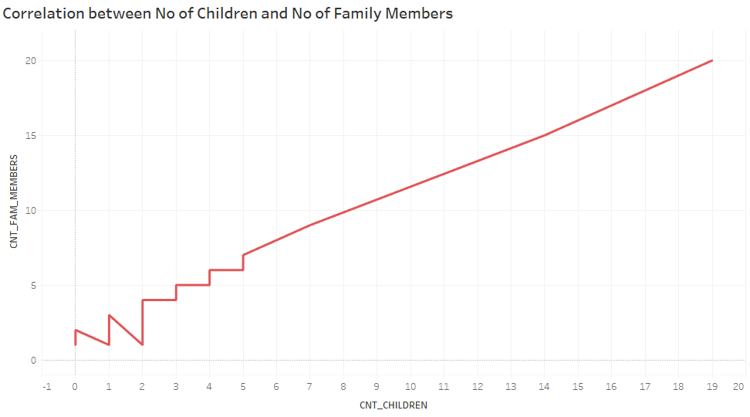

Slide 14
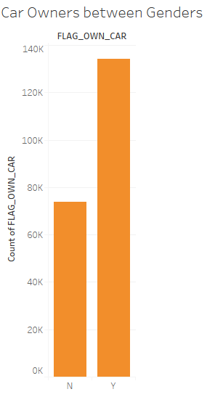

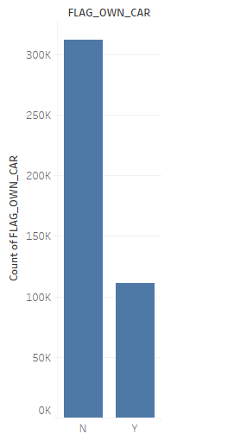
Some correlations we were expecting but…
There is a little correlation between car ownership and gender of a person in our dataset. The correlation factor is 0.58
W

Slide 15
Factors Influencing the probability of defaulting
After exhaustive feature selection, factors that best influence the probability of defaulting by an applicant are:
Income
Whether the applicant has a phone or not
Whether the applicant has an email or not
If the applicant is a student or not
If the applicant is a widow or not
If the applicant has completed higher education or not
If the applicant has completed secondary education or not
If the applicant has incomplete education or not

Slide 16
Feature set from each method
EXHAUSTIVE | STEP FORWARD & BACKWARD
AMT_INCOME_TOTAL FLAG_PHONE FLAG_EMAIL NAME_INCOME_TYPE Student NAME_EDUCATION_TYPE Higher NAME_EDUCATION_TYPE Incomplete NAME_EDUCATION_TYPE Secondary NAME_FAMILY_STATUS Widow MONTHS_BALANCE | CODE_GENDER AMT_INCOME_TOTAL FLAG_WORK_PHONE FLAG_PHONE FLAG_EMAIL CNT_FAM_MEMBERS NAME_INCOME_TYPE NAME_EDUCATION_TYPE NAME_FAMILY_STATUS DAYS_EMPLOYED MONTHS_BALANCE

Slide 17
Modeling
Some modeling that we attempted are:
Logistic Regression
Classification Tree Decision Tree
Random Forest
Support Vector Machine

Slide 18
INTERPRETATIONS OF CATEGORICAL VARIABLES

Slide 19
Influence of Higher education
When all other factors (such as income, phone status, email status, student status, widow status) remain constant, for a person who has completed Higher education the odds of getting a loan rejected is 1.34 times than that of a person without a Higher education.

Slide 20
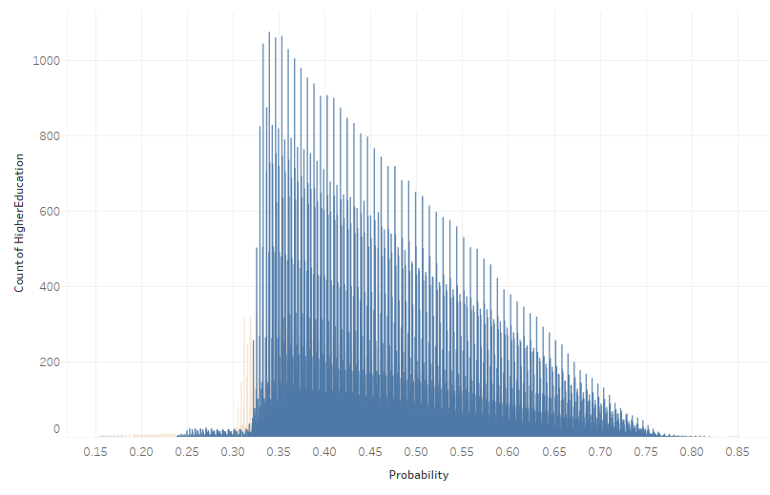
Probability Distribution for Applicants with Higher education

Slide 21
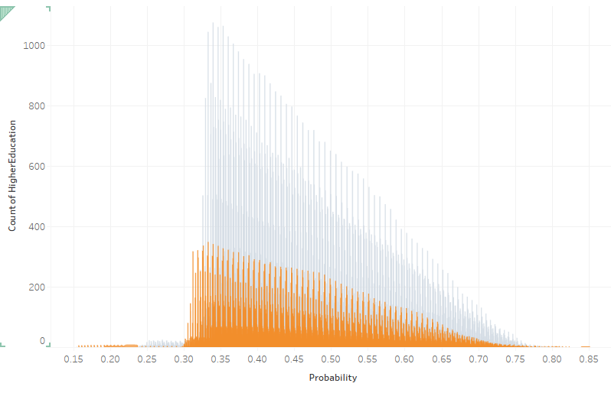
Probability Distribution for Applicants without Higher education

Slide 22
Influence of Secondary Education
When all other factors (such as income, phone status, email status, student status, widow status) remain constant, for a person who has completed Secondary education the odds of getting a loan rejected is 1.4 times than that of a person without a Secondary education.

Slide 23
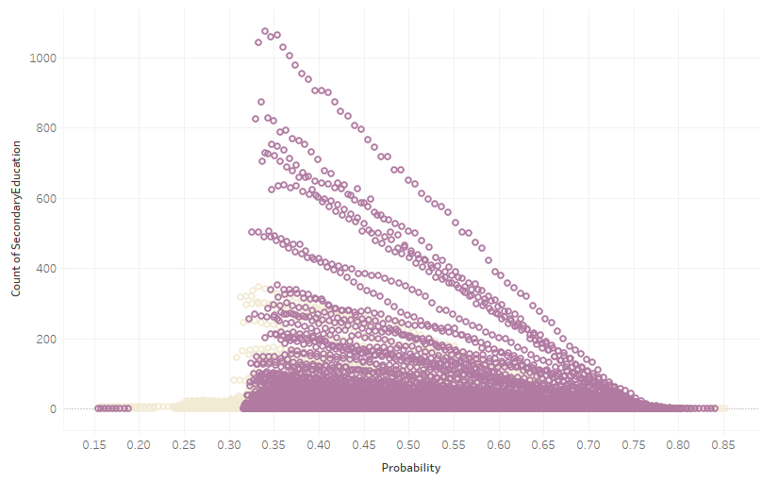
Probability Distribution for Applicants with Secondary education

Slide 24
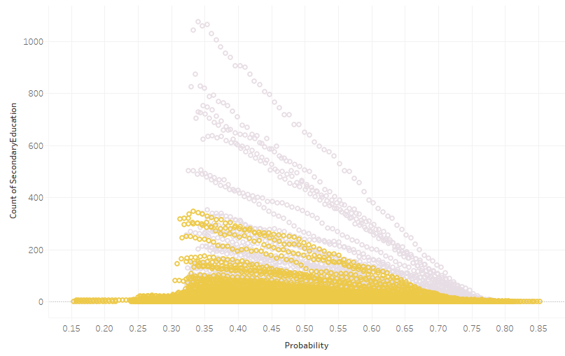
Probability Distribution for Applicants without Secondary education

Slide 25
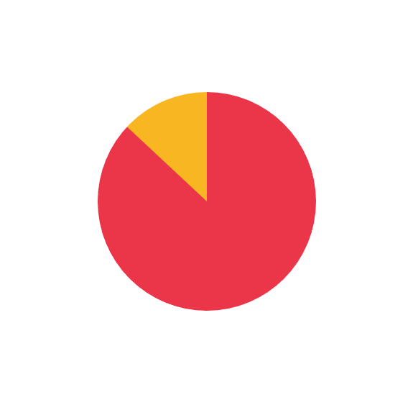
Influence of Widow:
When all other factors (such as income, phone status, email status, student status, Higher Education status) remain constant, for a person who is a widow, the odds of getting a loan rejected is 1.09 times than that of a person who is not a widow.

Slide 26
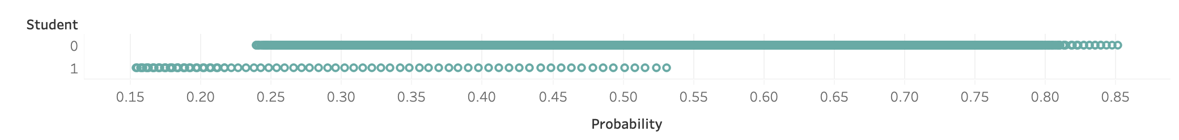
Influence of a Student
When all other factors (such as income, phone status, email status, Education status, widow status) remain constant, for a person who is a not a student has the odds of getting a loan rejected is 2.7 times than that of a person who is a student

Slide 27
Influence of Having a Phone
When all other factors (such as income, education status, email status,, widow status, Student Status) remain constant, for a person who has a phone the odds of getting a loan rejected is 1.064 times than that of a person who does not have a phone.

Slide 28
Influence of having an email
When all other factors (such as income, education status, phone status, widow status, Student Status) remain constant, for a person who has a email the odds of getting a loan rejected is 1.08 times than that of a person who does not have an email.

Slide 29
Influence of Incomplete Education
When all other factors (such as income,phone status, email status, widow status, Student Status) remain constant, for a person with incomplete education the odds of getting a loan rejected is 1.4 times than that of a person without incomplete education.

Slide 30
Interpretations of Continuous Variables

Slide 31
Influence of No of Months of Delayed Credit Payment
When all other factors (such as education status ,phone status, email status, widow status, Student Status) remain constant, for every unit increase in number of months of delayed credit payment the odds of not getting loan rejected increases 1.03 times.

Slide 32
Conclusion
Some takeaways from our study:
Some valid insights, we got were influence of being a widow and being a student.
Contrary to some general belief, our data suggests people with higher, secondary education have probability of defaulting more than others.
Strictly for this data, heuristically the credit history may not be the best deciding factor for approving a loan

